Slide 1


GOODCABS TRANSPORTATION & MOBILITY ANALYSIS
CODEBASICS RESUME PROJECT CHALLENGE 13
Domain - Transportation & Mobility
Presented by - GITIKA YADU

Slide 2
Content
1) About GoodCabs
2) Problem statement
3) Primary Analysis
4) Secondary Analysis & Recommendations
5) Dashborad Insights

Slide 3
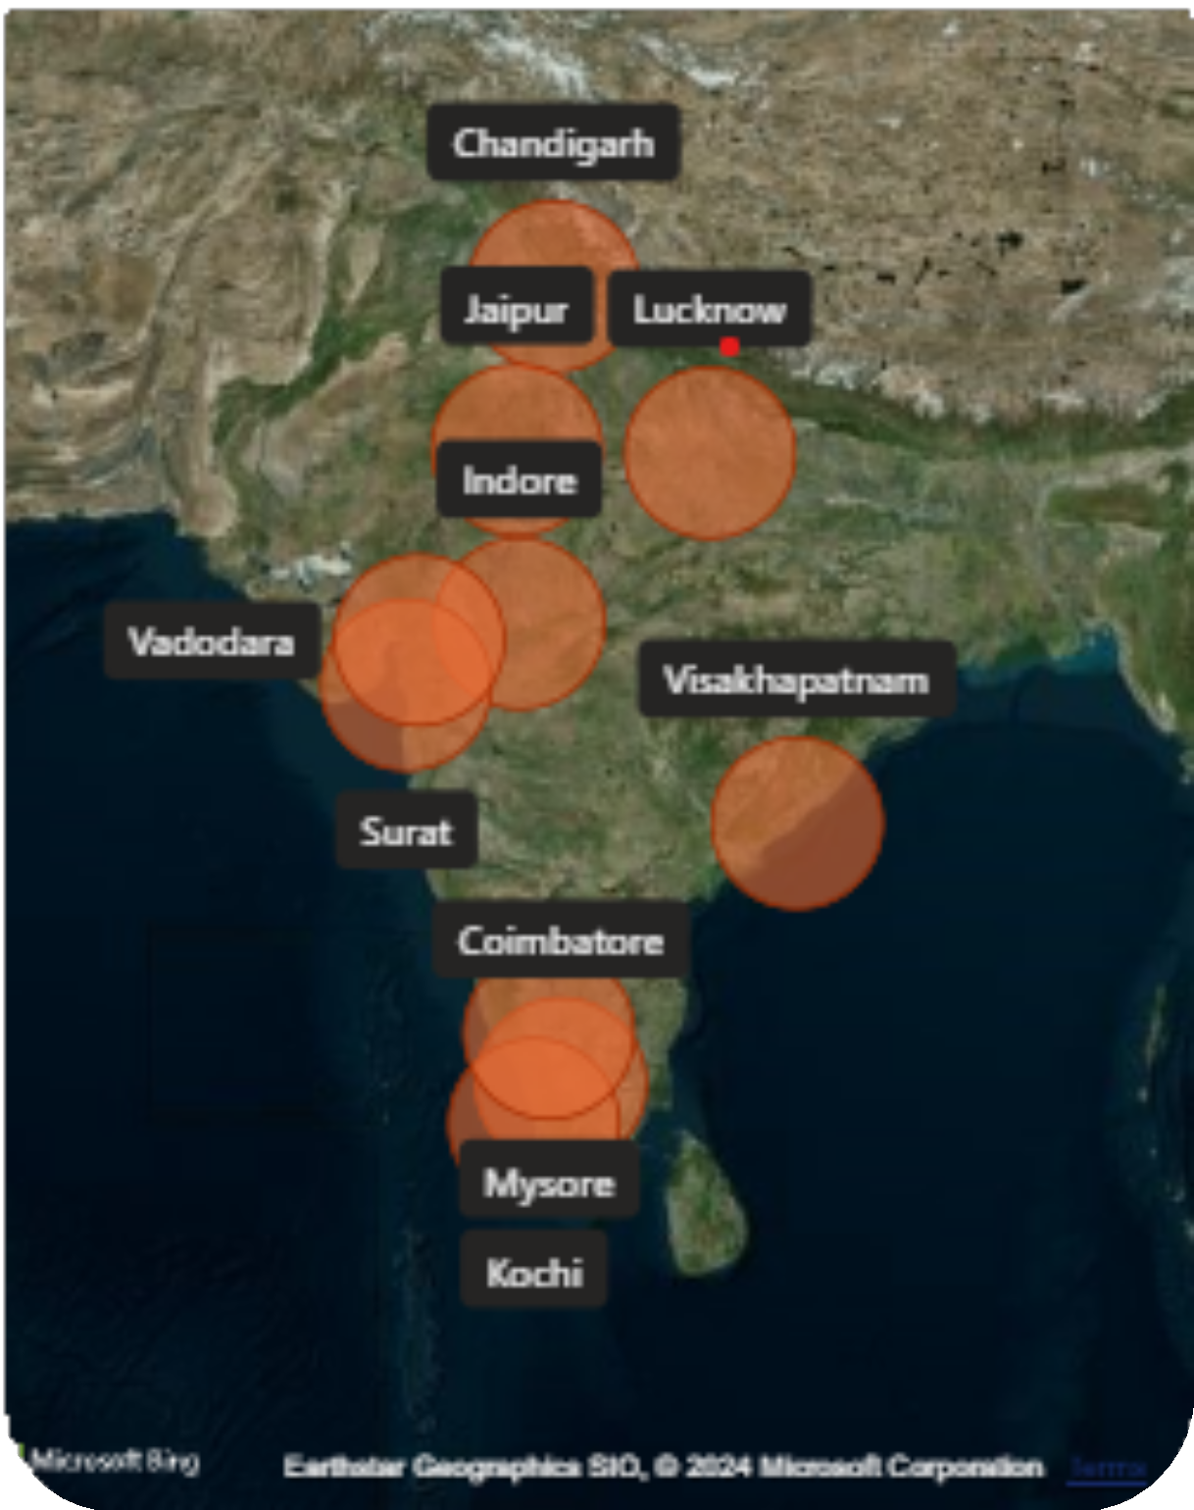
ABOUT
GOODCABS
Goodcabs is a cabs service company established 2 years ago and they focused on 10 tier-2 cities in India.
Supporting local drivers for sustainable livilihoods.
Ambitious goals for 2024 to enhance passenger satisfaction and business growth.

Slide 4
Problem Statement
Goodcabs Operating in tier-2 cities,aims to improve :
Evaluate key metrics like trip volume and passenger satisfaction..
Analyze repeat passenger rates and trip distribution.
Compare new vs repeat passenger trends.
Generate insights for 2024 growth & passenger satisfaction goals.
Address ad-hoc business questions using SQL.

Slide 5
PRIMARY ANALYSIS

Slide 6

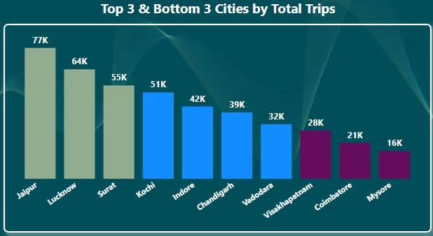
Identify the top 3 & bottom 3 cities by total trips over the entire analysis period.
Jaipur has 77K trips , Luckhnow has 64K & Surat has 55K are the top 3 Cities by total trips.
Out of 426K Overall Total Trips
Visakhapatnam has 28K total trips, Coimbatore has 21K & Mysore has 16K out of 426K Overall Total trips these all 3 Cities are the Bottom 3 Cities by Total trips

Slide 7

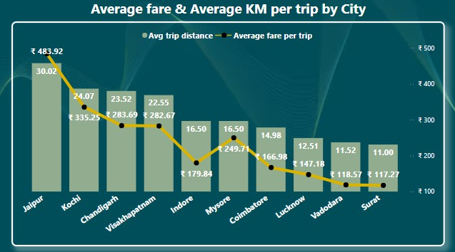
Calculate the average fare per trip for each city & compare it with the city’s average trip distance.Identify the cities with the highest and lowest average fare per trip to assess pricing efficiency across locations.
Jaipur has the highest average fare of 483.92 Rs with an average trip distance of 30.02km.
Surat has the lowest fare of 117.27 Rs with an average trip distance of 11.00km.

Slide 8

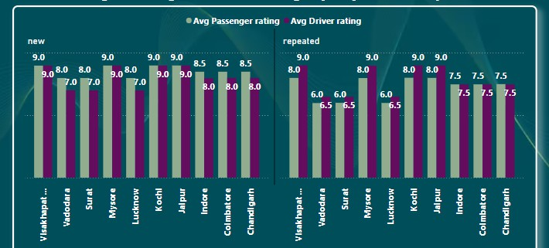
Calculate the average passengers & driver ratings for each city,segmented by passenger type (new vs
repeat).Identify cities with the highest & lowest average ratings.
Vishakhapatnam , Mysore , Kochi & Jaipur have the highest Passenger ratings & Driver ratings.
Vadodara , Surat & Luckhnow have the Lowest Passenger & Driver ratings for both New vs Repeated Passengers.

Slide 9
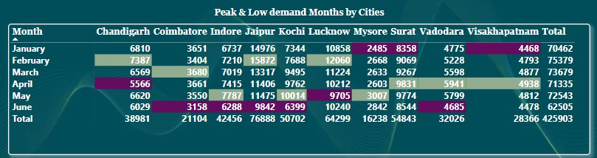
For each city, identify the month with the highest total trips (Peak Demand) & the month with the lowest total trips (Low Demand).This analysis will help Goodcabs understand seasonal patterns & adjust resources accordingly.
Low Demand Month is January for
Mysore , Surat & Visakhapatnam
For Chandigarh , Jaipur & Luckhnow
Peak Demand month is February.
For Indore , Kochi & Mysore May is Peak Demand month & April is Peak Demand month for Surat,Vadodara & Visakhapatnam
For Coimbatore Peak Demand month is
March.
For Chandigarh April is low Demand month & For Luckhnow Low Demand month is May.
June is Low Demand month for
Coimbatore,Indore,Jaipur,Kochi & Vadodara

Slide 10

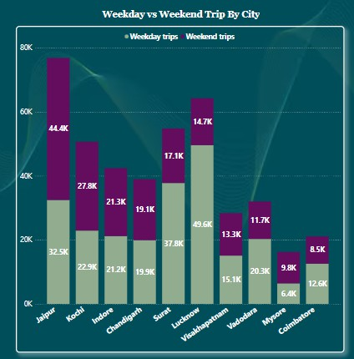
Compare the Total Trips taken on Weekdays Vs Weekends for each city over the 6 month period.Identify cities with a strong preference for either Weekend or Weekday trips to understand demand variations.
Surat , Luckhnow,Vadodara, Visakhapatam & Coimbatore cities with the highest Weekday Demand.
Jaipur,Kochi & Mysore cities have highest Weekend Demand.
Indore & Chandigarh cities have the balanced demand for both Weekdays & Weekends trtip.

Slide 11
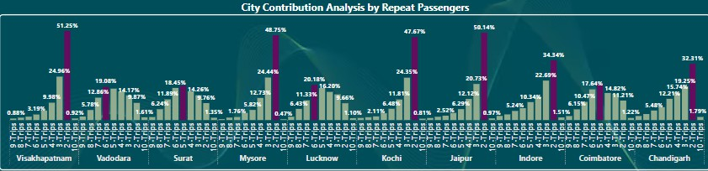
Analyse the frequency of trips taken by repeat passengers in each city(e.g.,% of repeat passengers taking 2 trips,3 trips etc.).Identify which cities contribute most to higher trip frequencies among repeat passengers,& examine if there are distinguishable patterns between tourism-focused & business-focused cities.
Visakhapatnam , Mysore , Kochi & Jaipur have the most repeat passengers take only 2 trips (around 50%)
10-trips represent the minimum number of trips taken by repeat passengers across all the cities.

Slide 12
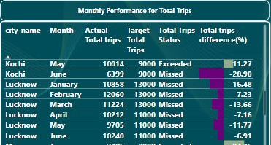
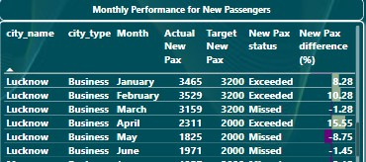

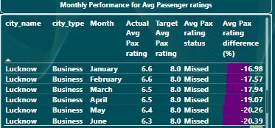
For each city, evaluate monthly performance against targets for total trips, new passengers, and average passenger ratings. From targets_db.Determine if each metric met , exceeded or missed the target, and calculate the percentage difference. Identify any consistent patterns in target achievement, particularly across tourism versus business-focused cities.
Luckhnow missed its total trips & Average passenger ratings targets across all months
But Luckhnow exceeded its New Passenger target in January,February & April but it missed the target in other months.

Slide 13

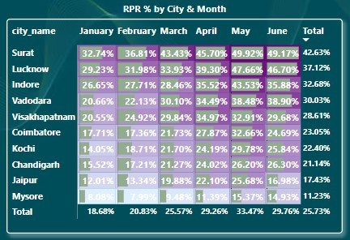
Analyze the repeat passenger rate (RPR%), for each city across the six-month period. Identify the top 2 and bottom 2 cities based on their RPR% to determine which locations have the strongest and weakest rates.
Similarly, analyse the RPR% by month across all cities and identify the months with the highest and lowest repeat passenger rates. This will help to pinpoint any seasonal patterns or months with higher repeat passenger loyalty.
Surat & Luckhnow are the top 2 cities & Jaipur & Mysore are the Bottom 2 Cities by their RPR%
Month May has the highest RPR% while January has the lowest RPR% across all cities

Slide 14
SECONDARY ANALYSIS & RECOMMENDATIONS
Factors influencing Repeat Passenger Rate (RPR%)
Quality of service : Focus on improving service quality and offer loyalty programs (discounts , rewards) & provide good environment to keep passengers coming back.
Competitive Pricing : Goodcabs should offer affordable prices with well-maintained cabs & comfortable rides.This combination will help attract repeat passengers.
City Demographics : Focus on offering premium options in wealthier areas & affordable,efficient options in middle-income regions.
Tourism Vs Business demand impact
Seasonal Demand :Tourism seasons & local events or holidays like festivals, Wedding & functions significantly increase demand for Goodcabs.
Goodcabs should offering promotions during peak times or targeting popular tourist spots,can help boost trip volume in Tourism cities.

Slide 15
SECONDARY ANALYSIS & RECOMMENDATIONS
Emerging Mobility Trends
Electric Vehicle (EV) Adoption & Green Energy Use : EV Vehicle adoption is a growing trend that supports eco friendly transportation.Goodcabs should consider integating EVs to promote enviromental responsibility and reduce pollution in cities this adoption of EVs are reshaping the cab service market,especially in Tier-2 cities.
Partner Opportunities with Local Businesses
Goodcabs can work with local businesses like hotels , malls & event venues to attract more customers and this initiative can help increase demand , especially in popular tourist spots or busy areas & build customer loyalty.
Data Collection for Enhanced Data- Driven- Decision
Collect customer details like Age , Gender & location. Gather data on peak trip times to improve scheduling. Track trip habbits & customer feedback to improve quality.

Slide 16
Dashboard

Slide 17
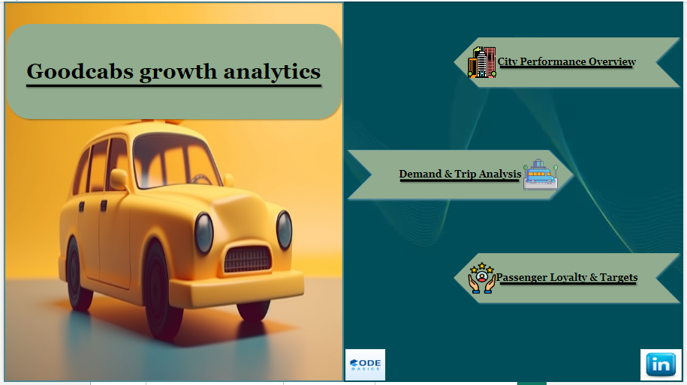

Slide 18
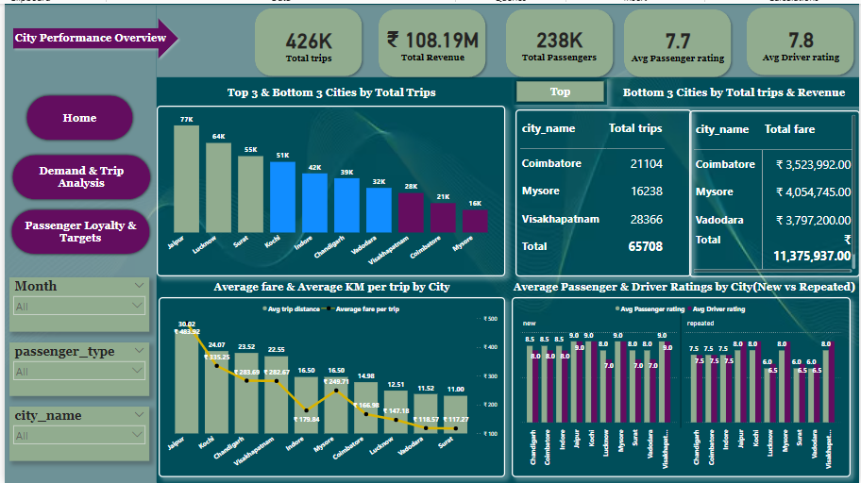

Slide 19
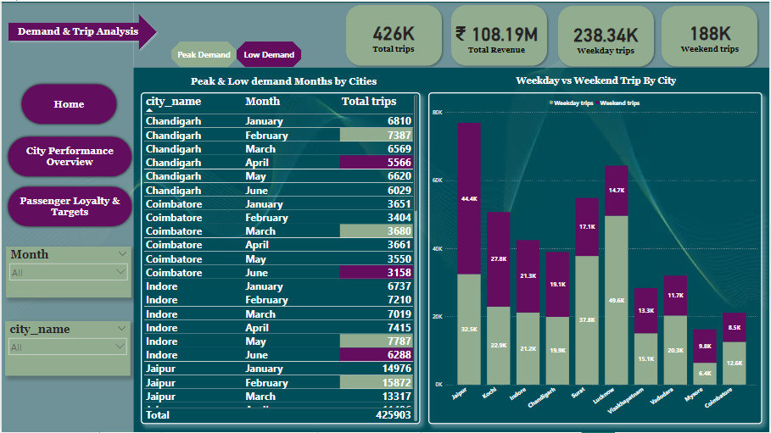

Slide 20
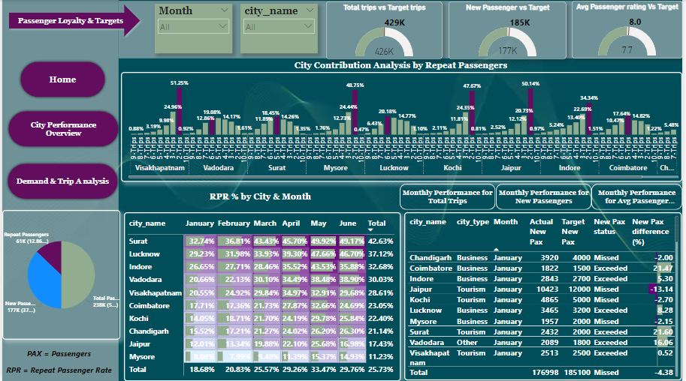

Slide 21
THANK YOU

